Slide 1
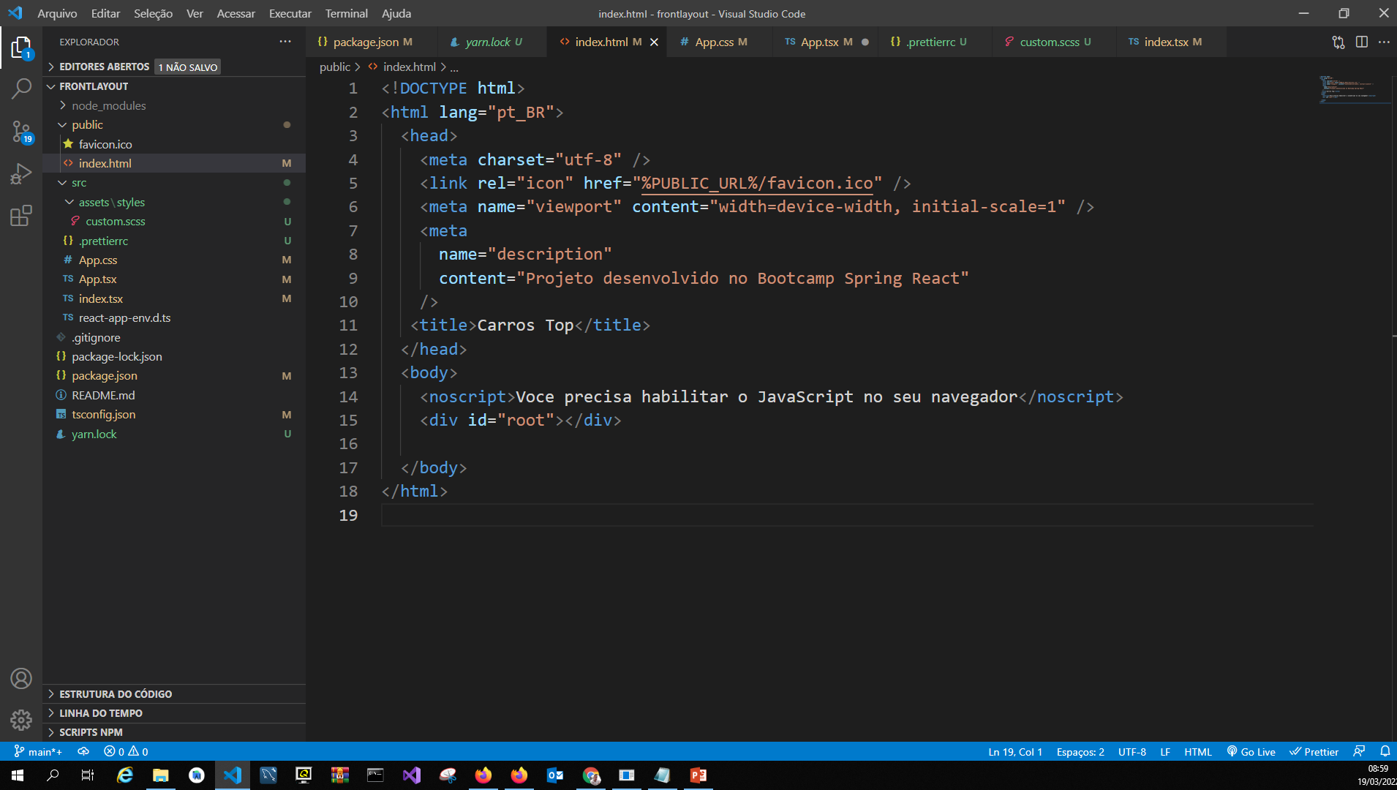

Slide 2
Index Html
<!DOCTYPE html>
<html lang="pt_BR">
<head>
<meta charset="utf-8" />
<link rel="icon" href="%PUBLIC_URL%/favicon.ico" />
<meta name="viewport" content="width=device-width, initial-scale=1" />
<meta
name="description"
content="Projeto desenvolvido no Bootcamp Spring React"
/>
<title>Carros Top</title>
</head>
<body>
<noscript>Voce precisa habilitar o JavaScript no seu navegador</noscript>
<div id="root"></div>
</body>
</html>

Slide 3
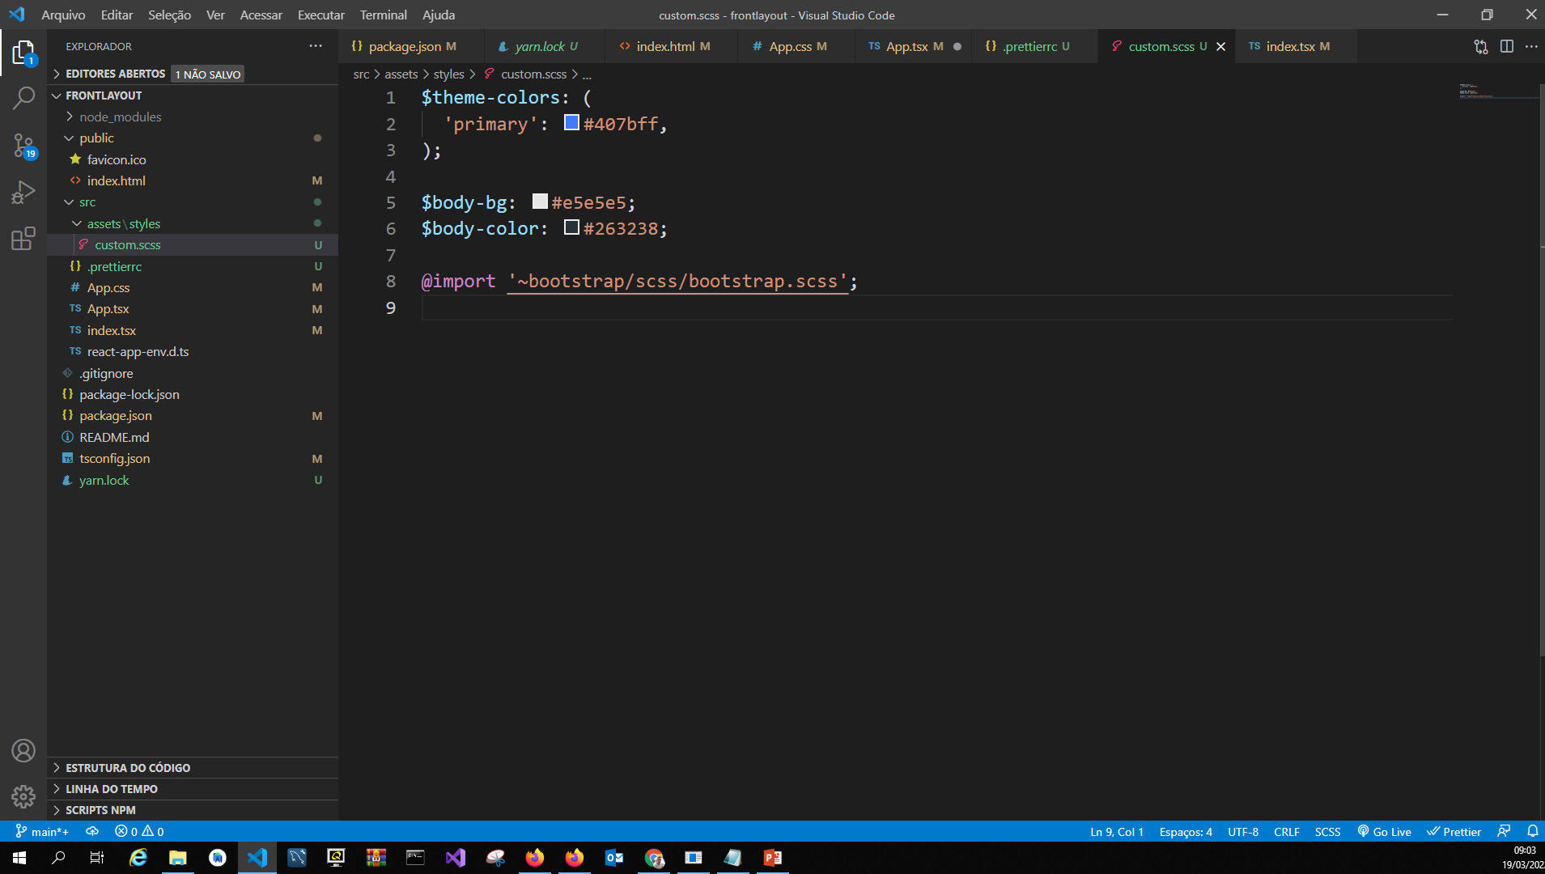

Slide 4
Custom.scss
$theme-colors: (
'primary': #407bff,
);
$body-bg: #e5e5e5;
$body-color: #263238;
@import '~bootstrap/scss/bootstrap.scss';

Slide 5
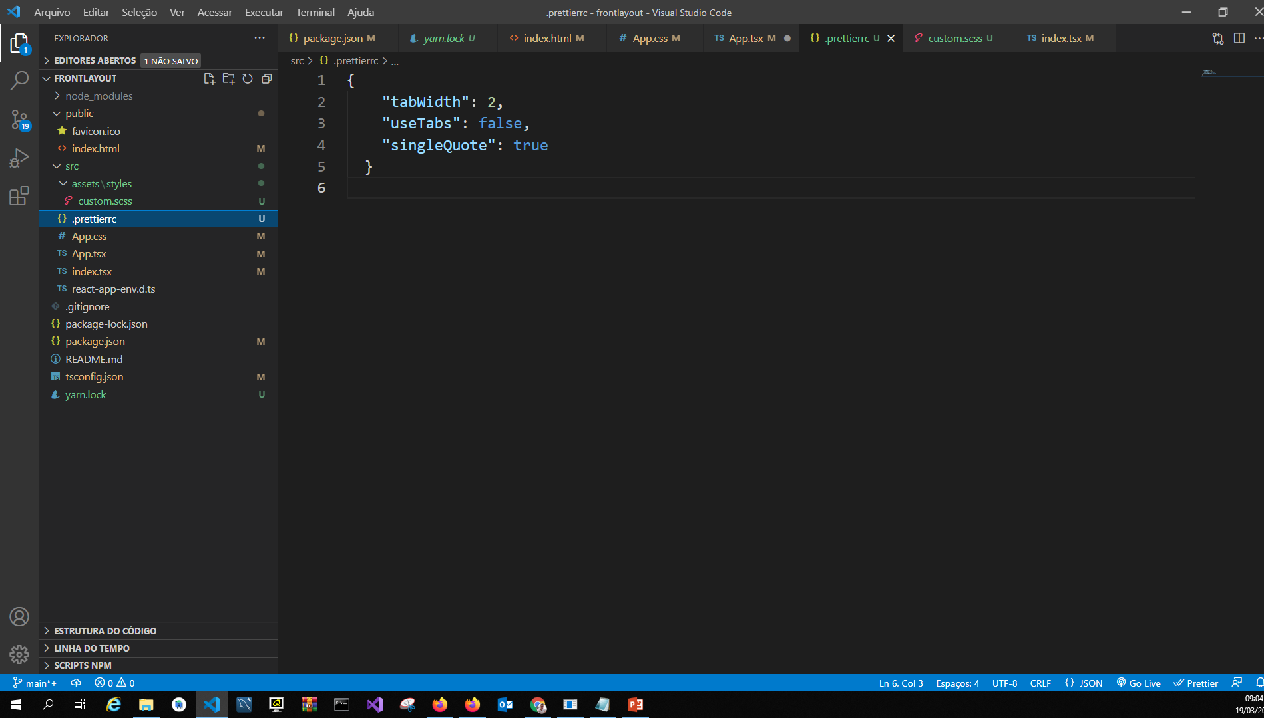

Slide 6
.prettierrc
{
"tabWidth": 2,
"useTabs": false,
"singleQuote": true
}

Slide 7
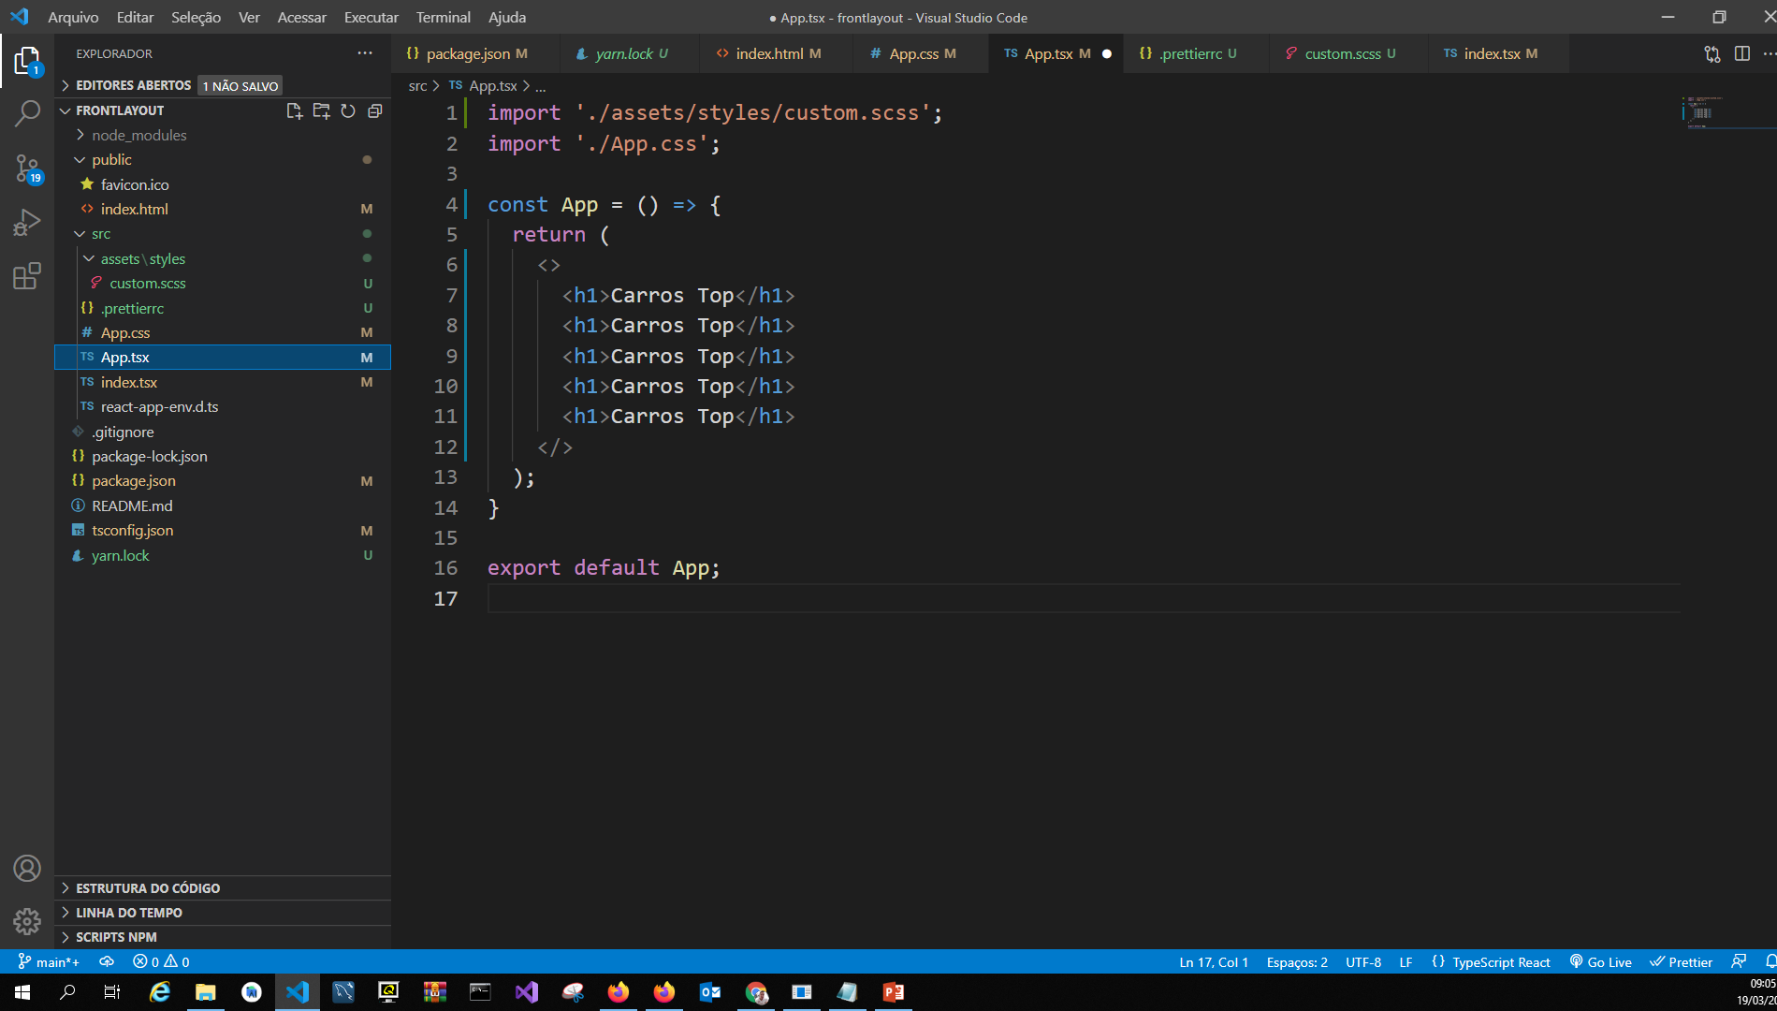

Slide 8
App.tsx
import Navbar from 'components/Navbar';
import './assets/styles/custom.scss';
import './App.css';
const App = () => {
return (
<>
<Navbar />
<h1>Carros Top</h1>
</>
);
}
export default App;

Slide 9
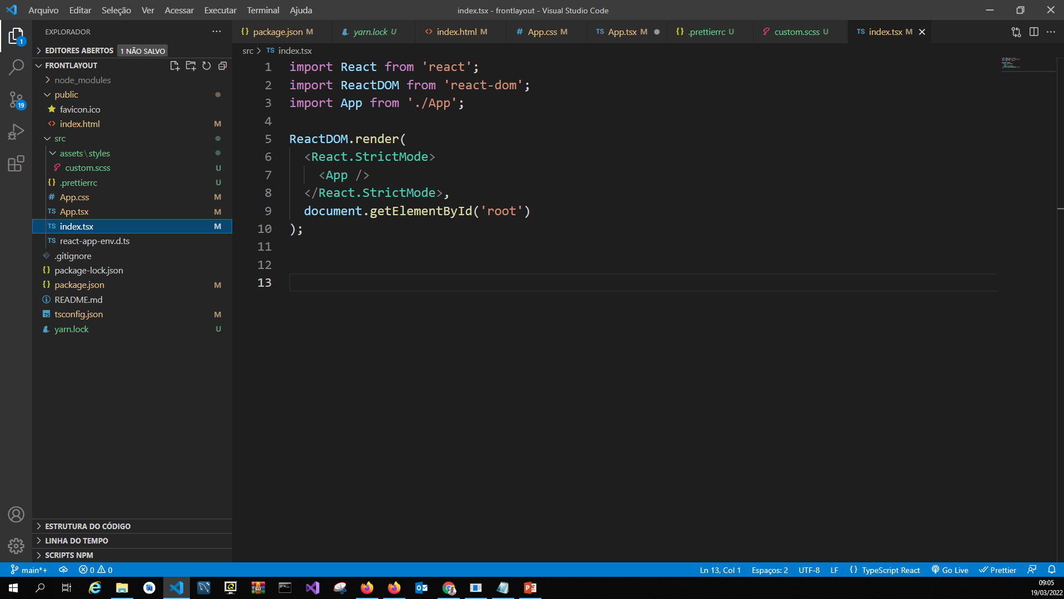

Slide 10
index.tsx
import React from 'react';
import ReactDOM from 'react-dom';
import App from './App';
ReactDOM.render(
<React.StrictMode>
<App />
</React.StrictMode>,
document.getElementById('root')
);

Slide 11
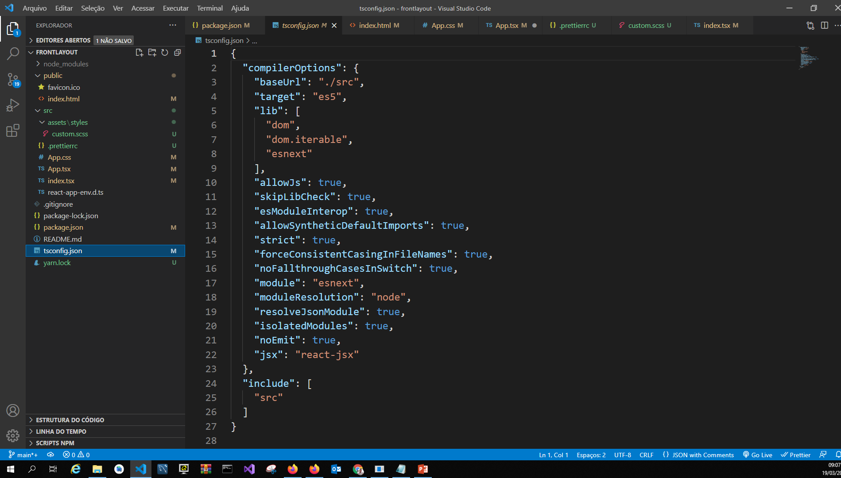

Slide 12
Tsconfig.json
{
"compilerOptions": {
"baseUrl": "./src",
"target": "es5",
"lib": [
"dom",
"dom.iterable",
"esnext"
],

Slide 13
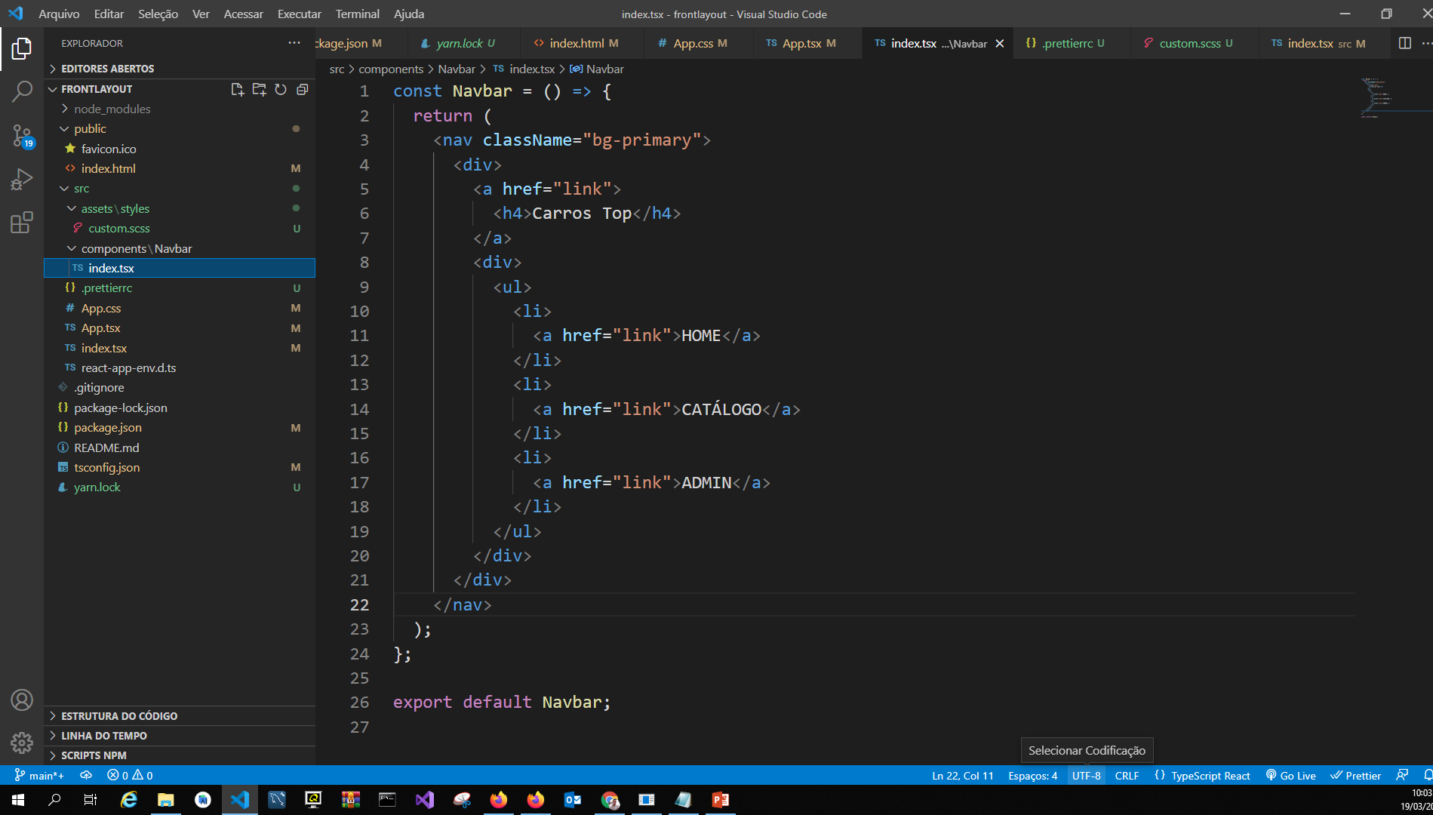

Slide 14
Primeiro componente: Navbar – Menu de catalogo com hamburg
const Navbar = () => {
return (
<nav className="bg-primary">
<div>
<a href="link">
<h4>Carros Top</h4>
</a>
<div>
<ul>
<li>
<a href="link">HOME</a>
</li>
<li>
<a href="link">CATÁLOGO</a>
</li>
<li>
<a href="link">ADMIN</a>
</li>
</ul>
</div>
</div>
</nav>
);
};
export default Navbar;

Slide 15
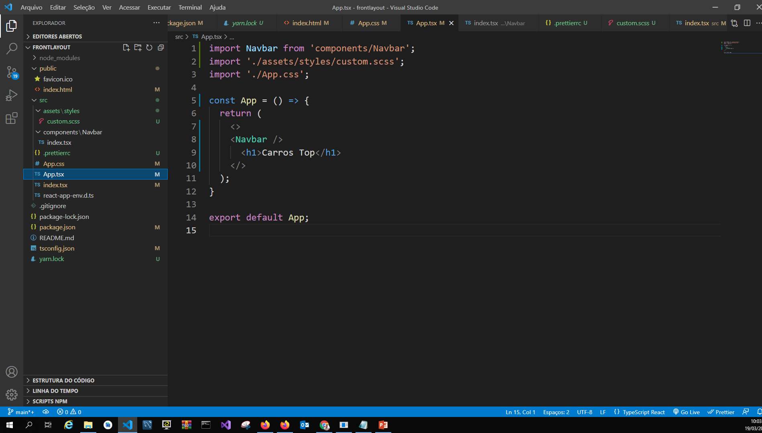

Slide 16
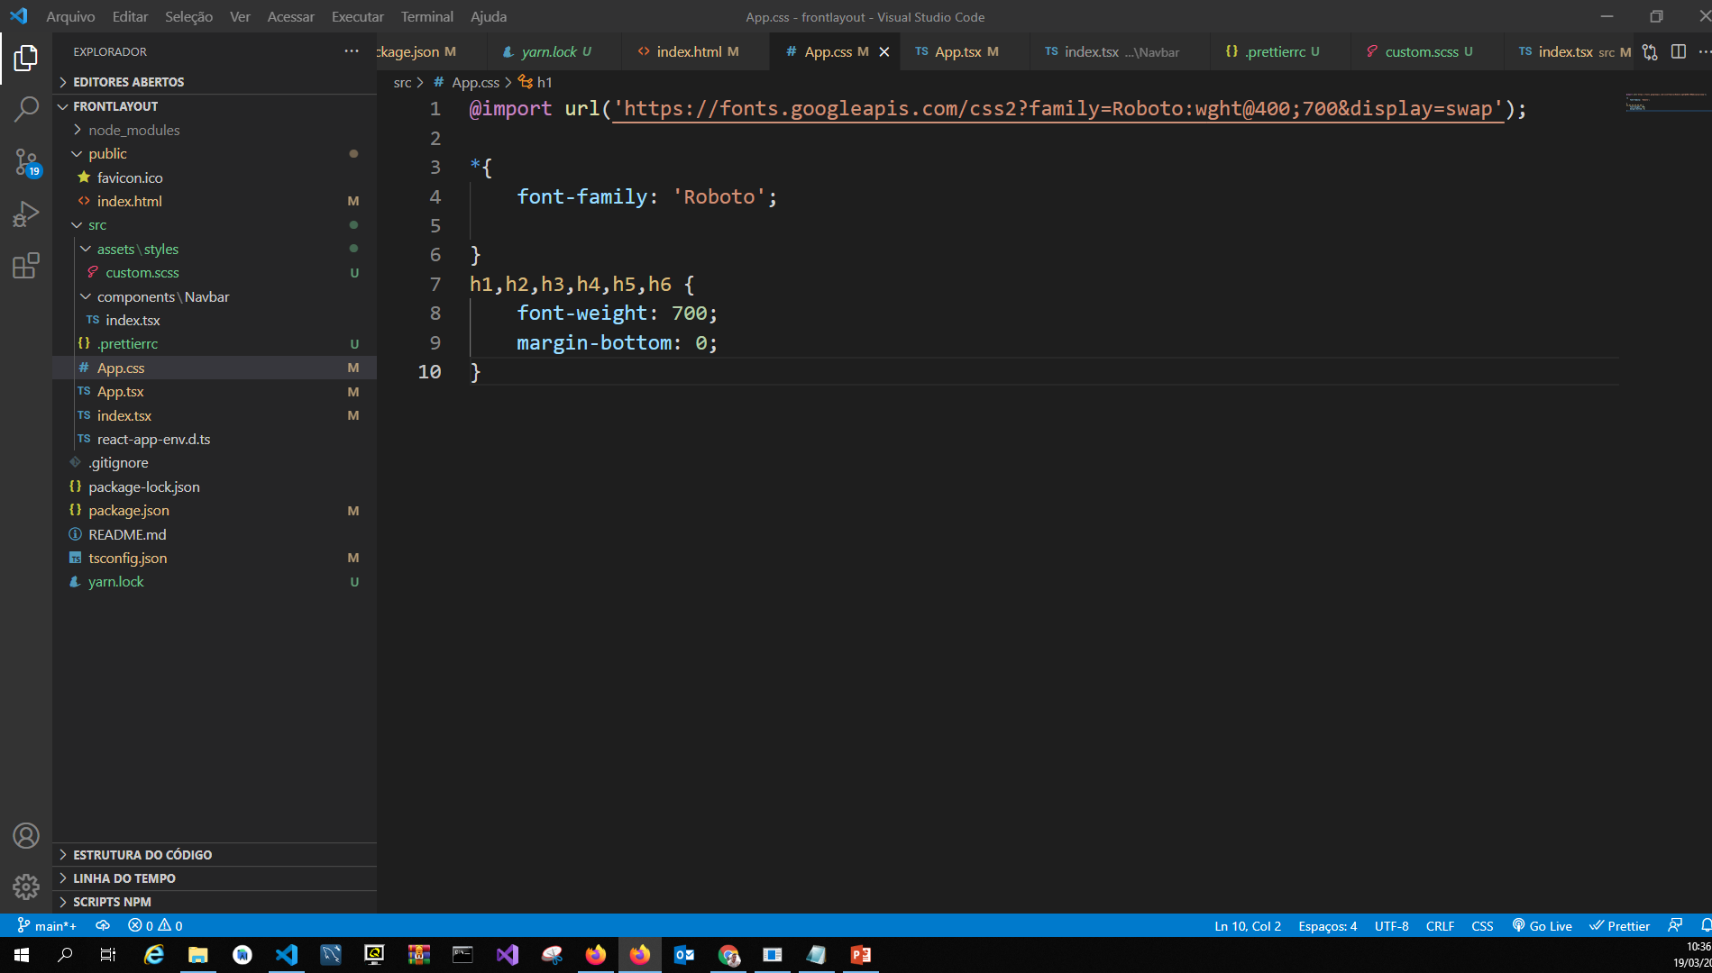

Slide 17
@import url('https://fonts.googleapis.com/css2?family=Roboto:wght@400;700&display=swap');
*{
font-family: 'Roboto';
}
h1,h2,h3,h4,h5,h6 {
font-weight: 700;
margin-bottom: 0;
}

Slide 18
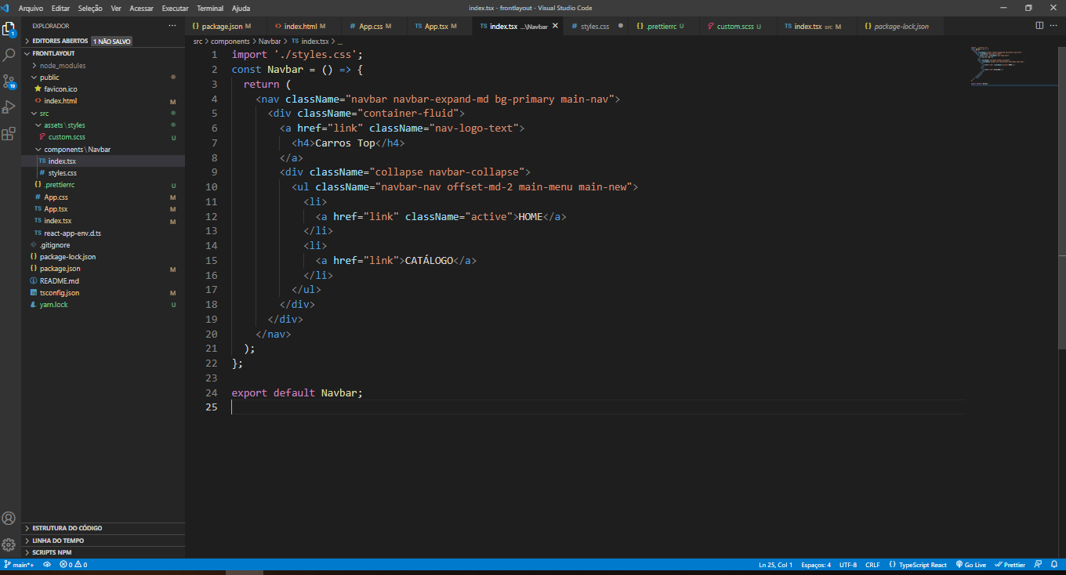

Slide 19
import './styles.css';
const Navbar = () => {
return (
<nav className="navbar navbar-expand-md bg-primary main-nav">
<div className="container-fluid">
<a href="link" className="nav-logo-text">
<h4>Carros Top</h4>
</a>
<div className="collapse navbar-collapse">
<ul className="navbar-nav offset-md-2 main-menu main-new">
<li>
<a href="link" className="active">HOME</a>
</li>
<li>
<a href="link">CATÁLOGO</a>
</li>
</ul>
</div>
</div>
</nav>
);
};
export default Navbar;

Slide 20
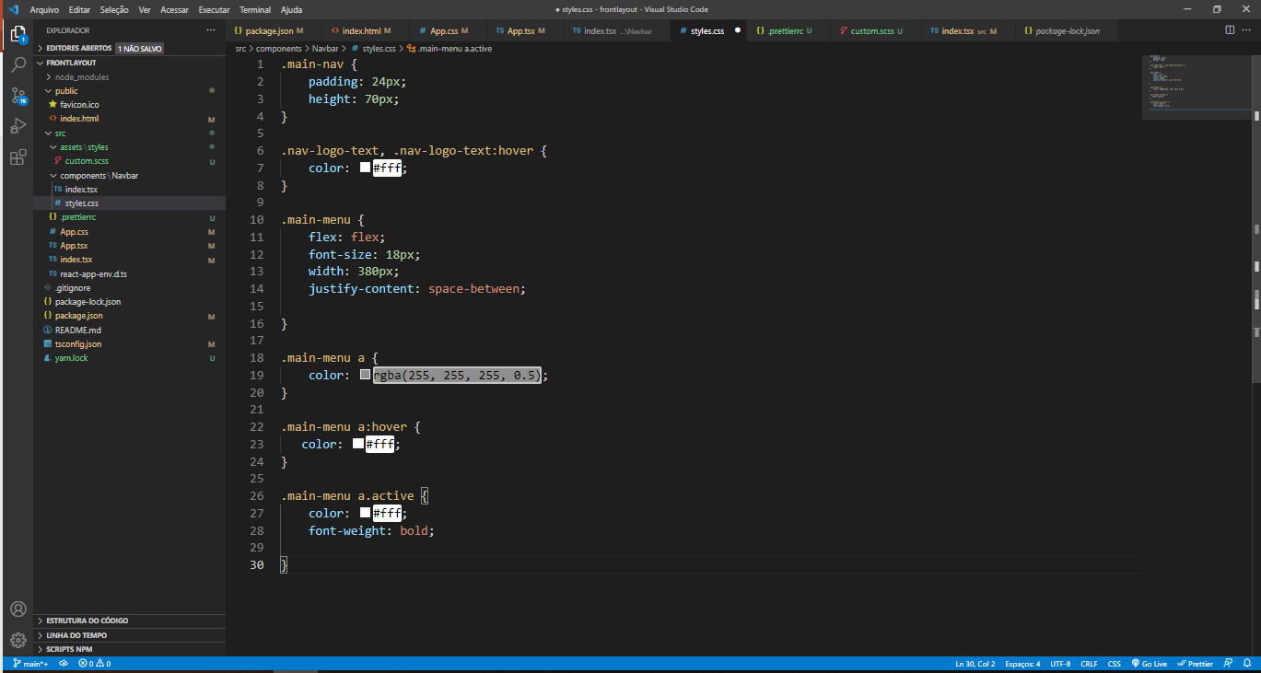

Slide 21
.main-nav {
padding: 24px;
height: 70px;
}
.nav-logo-text, .nav-logo-text:hover {
color: #fff;
}
.main-menu {
flex: flex;
font-size: 18px;
width: 380px;
justify-content: space-between;
}
.main-menu a {
color: rgba(255, 255, 255, 0.5);
}
.main-menu a:hover {
color: #fff;
}
.main-menu a.active {
color: #fff;
font-weight: bold;
}

Slide 22
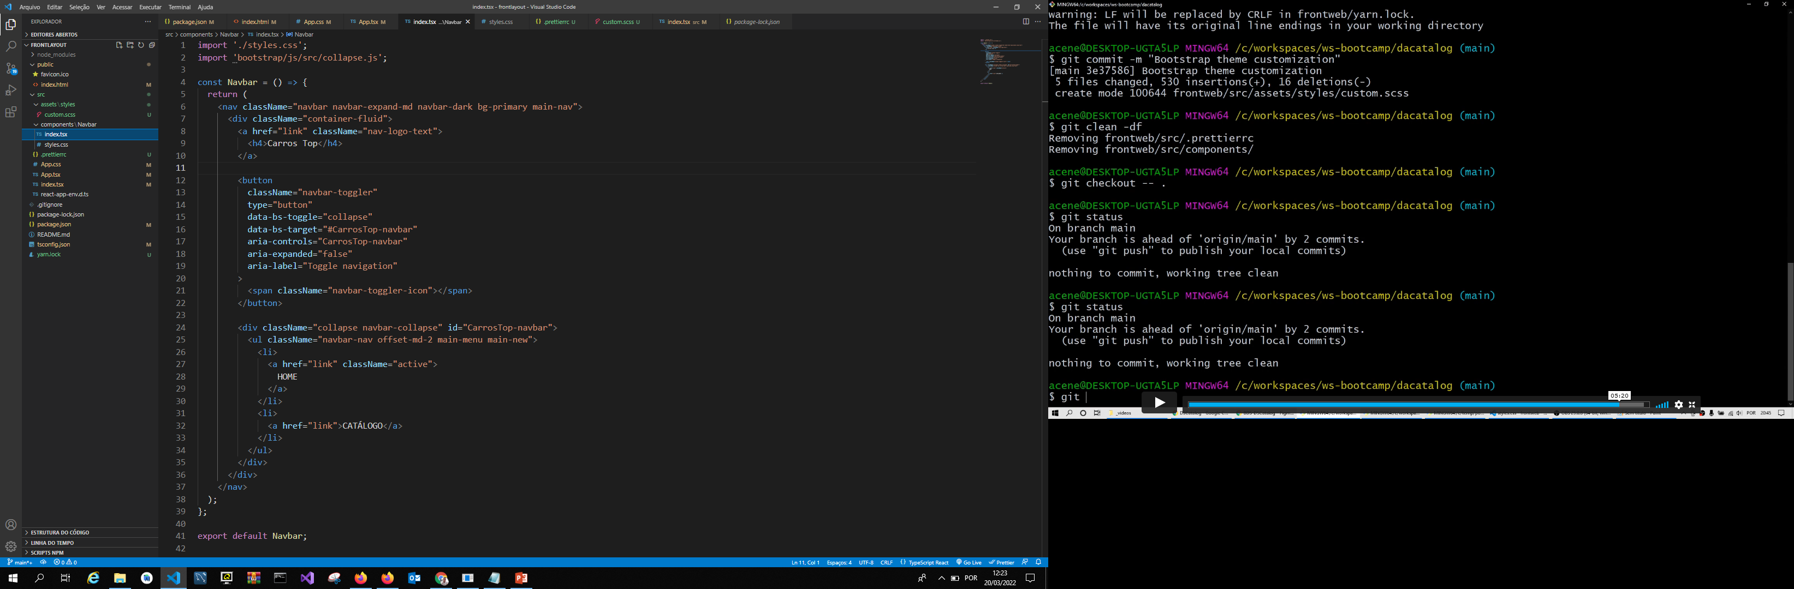
Menu Hamburguer – acréscimo “navbar-dark” e min-height: 70px;

Slide 23
import './styles.css';
import 'bootstrap/js/src/collapse.js';
const Navbar = () => {
return (
<nav className="navbar navbar-expand-md navbar-dark bg-primary main-nav">
<div className="container-fluid">
<a href="link" className="nav-logo-text">
<h4>Carros Top</h4>
</a>
<button
className="navbar-toggler"
type="button"
data-bs-toggle="collapse"
data-bs-target="#CarrosTop-navbar"
aria-controls="CarrosTop-navbar"
aria-expanded="false"
aria-label="Toggle navigation"
>
<span className="navbar-toggler-icon"></span>
</button>
<div className="collapse navbar-collapse" id="CarrosTop-navbar">
<ul className="navbar-nav offset-md-2 main-menu main-new">
<li>
<a href="link" className="active">
HOME
</a>
</li>
<li>
<a href="link">CATÁLOGO</a>
</li>
</ul>
</div>
</div>
</nav>
);
};
export default Navbar;
.main-nav {
padding: 24px;
min-height: 70px;
}
.nav-logo-text, .nav-logo-text:hover {
color: #fff;
}
.main-menu {
flex: flex;
font-size: 18px;
width: 380px;
justify-content: space-between;
}
.main-menu a {
color: rgba(255, 255, 255, 0.5);
}
.main-menu a:hover {
color: #fff;
}
.main-menu a.active {
color: #fff;
font-weight: bold;
}

Slide 24
Exportar imagem do figma

